Slide 1
Web Services
M. L. Liu
Distributed Computing, M. L. Liu

Slide 2
Sources of Information
Programming Web Services with SOAP, by Snell et al, O’Reilly
SOAP Tutorial, http://www.w3schools.com/soap/default.asp
SoapRPC.com: Tutorials, (http://www.soaprpc.com/tutorials/) A Busy Developer’s Guide To Soap1.1
DaveNet : XML-RPC for Newbies, http://davenet.userland.com/1998/07/14/xmlRpcForNewbies
SoapRPC.com: Other resources, http://www.soaprpc.com/resources/
Distributed Computing, M. L. Liu

Slide 3
Web Services
Network services provided over HTTP – “wired services”
It is promoted as a new way to build network applications from distributed components that are language- and platform-independent
The technologies are still evolving
We are more interested in the concept and principles, but we will look into one API (Apache SOAP).
Distributed Computing, M. L. Liu

Slide 4
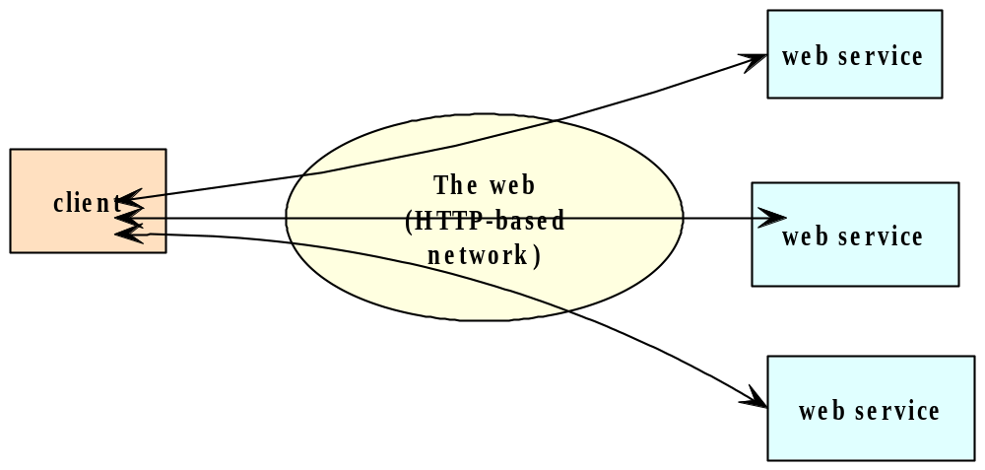
Web Services
Distributed Computing, M. L. Liu

Slide 5
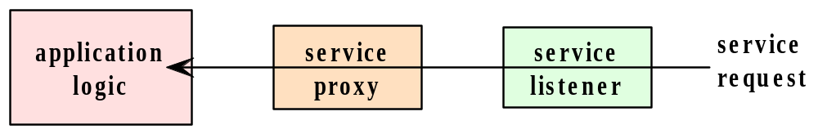
Web Service Software Components
A web service is a message-based network service.
A server which provides a web service must be capable of “sending and receiving messages using some combination of standard Internet protocols”
Distributed Computing, M. L. Liu

Slide 6
Just-in-time integration
Network services can be integrated dynamically, on an as-needed basis.
SunMicro’s jini is a framework that supports the idea.
Network services are registered with a service registry; a service consumer/client looks up the registry to fulfill its needs.
The binding of a client to the service can occur at runtime.
Distributed Computing, M. L. Liu

Slide 7
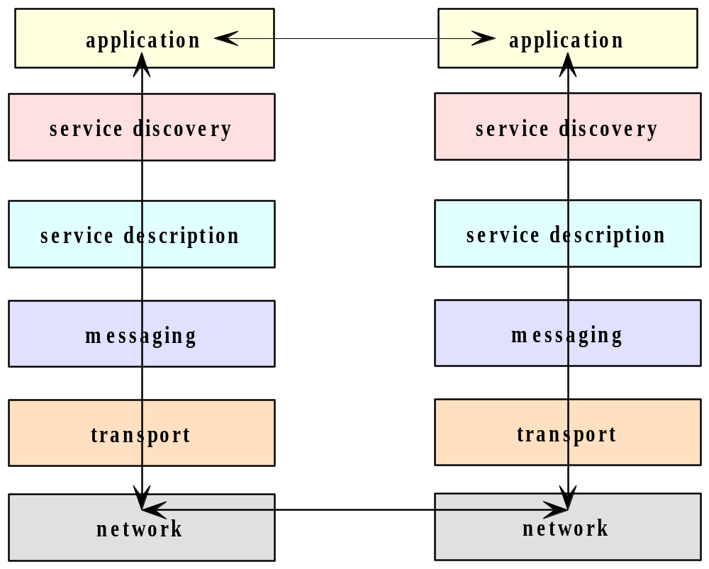
Web service protocol stack
Distributed Computing, M. L. Liu

Slide 8
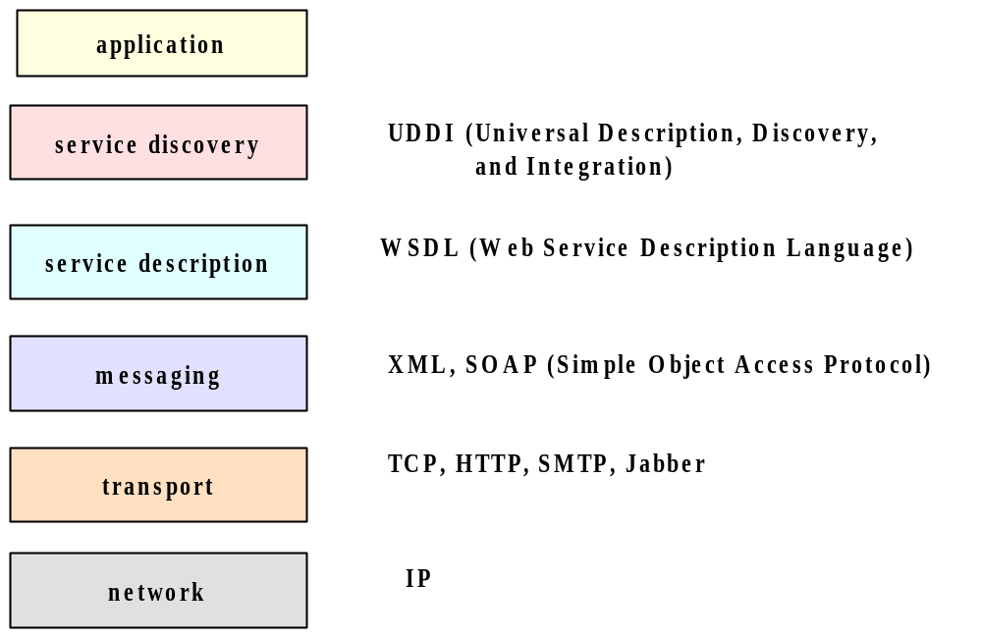
Web service protocols
Distributed Computing, M. L. Liu

Slide 9
SOAP
SOAP is a protocol which applies XML for message exchange in support of remote method calls over the Internet.
Compared to remote method invocation or CORBA-based facilities:
  SOAP is web-based or “wired” and hence is not subject to firewall restrictions
  Language-independent
  Can provide just-in-time service integration
Distributed Computing, M. L. Liu

Slide 10
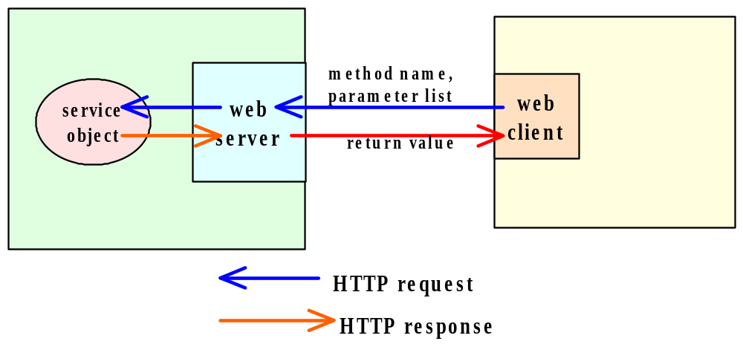
Remote Procedure Call using HTTP
Distributed Computing, M. L. Liu

Slide 11
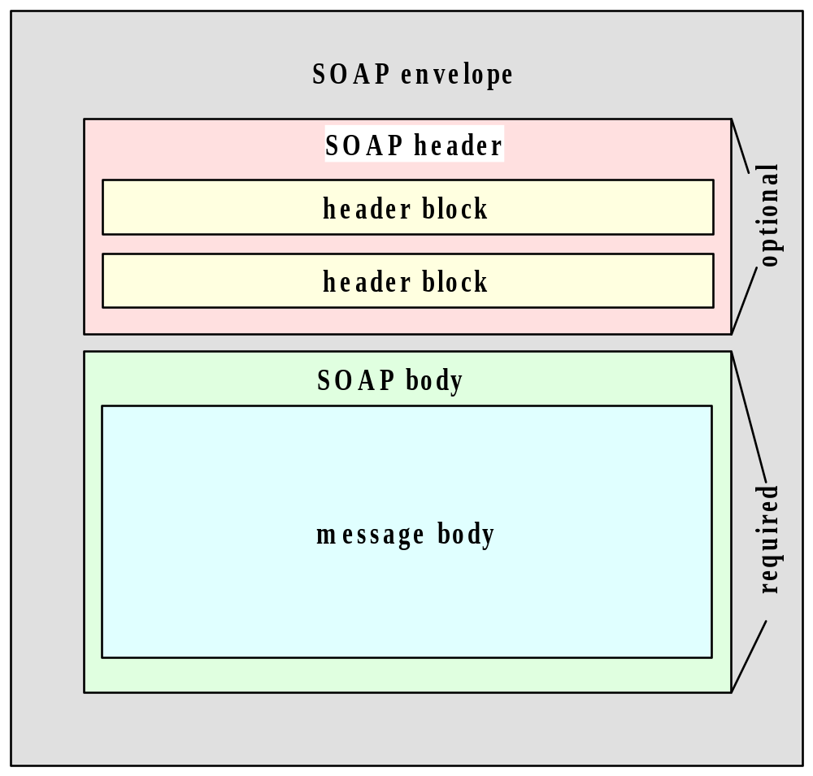
SOAP Messages
Distributed Computing, M. L. Liu

Slide 12
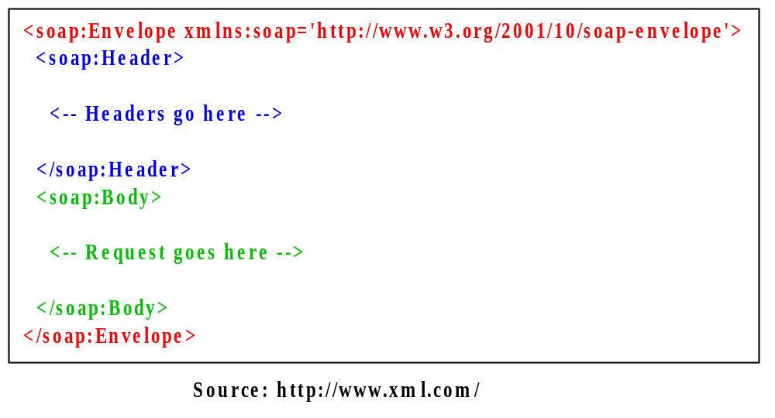
An XML-encoded SOAP RPC
Distributed Computing, M. L. Liu

Slide 13
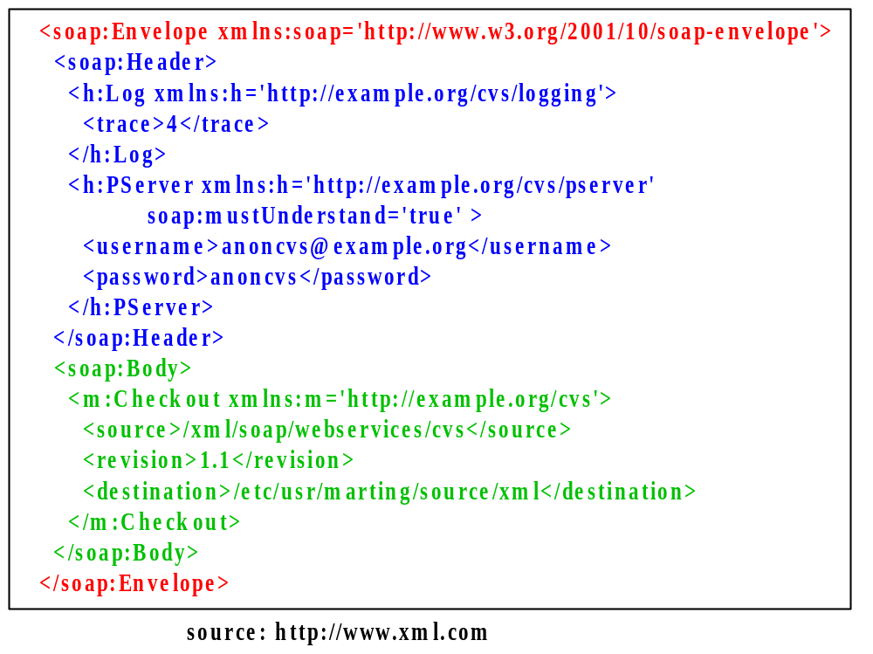
Example of a SOAP message
Distributed Computing, M. L. Liu

Slide 14
A SOAP Message that contains a remote procedure call source: (http://www.soaprpc.com/tutorials/) A Busy Developer’s Guide To Soap1.1
<SOAP-ENV:Envelope
SOAP-ENV:encodingStyle=
"http://schemas.xmlsoap.org/soap/encoding/"
xmlns:SOAP-ENC="http://schemas.xmlsoap.org/soap/encoding/" xmlns:SOAP-ENV="http://schemas.xmlsoap.org/soap/envelope/" xmlns:xsd="http://www.w3.org/1999/XMLSchema" xmlns:xsi="http://www.w3.org/1999/XMLSchema-instance">
<SOAP-ENV:Body>
<m:getStateName xmlns:m="http://www.soapware.org/">
<statenum xsi:type="xsd:int">41</statenum>
</m:getStateName>
</SOAP-ENV:Body>
</SOAP-ENV:Envelope>
Distributed Computing, M. L. Liu

Slide 15
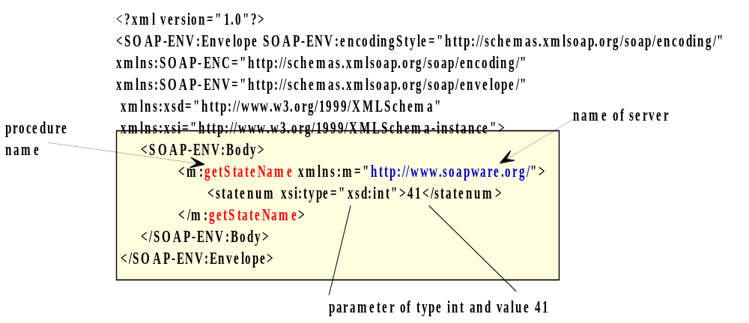
An Example SOAP Request source: (http://www.soaprpc.com/tutorials/) A Busy Developer’s Guide To Soap1.1
Distributed Computing, M. L. Liu

Slide 16
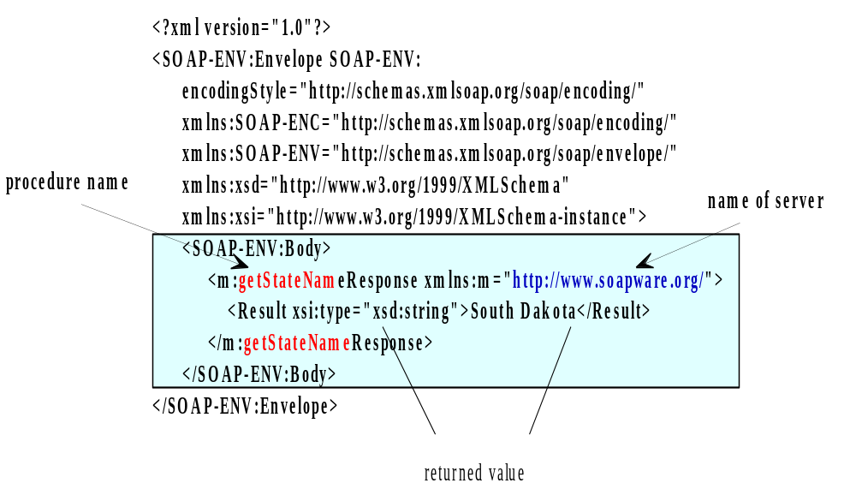
Response example source: (http://www.soaprpc.com/tutorials/) A Busy Developer’s Guide To Soap1.1
Distributed Computing, M. L. Liu

Slide 17
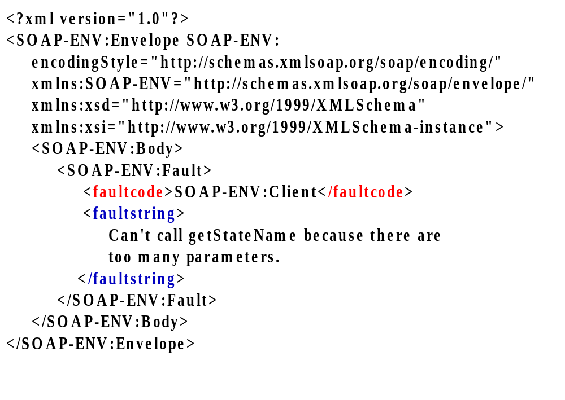
Example of a SOAP message for an error RPC response source: (http://www.soaprpc.com/tutorials/) A Busy Developer’s Guide To Soap1.1
Distributed Computing, M. L. Liu

Slide 18
HTTP and SOAP RPC Request source: (http://www.soaprpc.com/tutorials/) A Busy Developer’s Guide To Soap1.1
A SOAP message can be used to transport a SOAP remote procedure request/response, as follows:
  POST /examples HTTP/1.1
  User-Agent: Radio UserLand/7.0 (WinNT)
  Host: localhost:81
  Content-Type: text/xml; charset=utf-8
  Content-length: 474
  SOAPAction: "/examples"
  <blank line>
  <text for SOAP message>
Distributed Computing, M. L. Liu

Slide 19
An HTTP request that carries a SOAP RPC request source: (http://www.soaprpc.com/tutorials/) A Busy Developer’s Guide To Soap1.1
POST /examples HTTP/1.1
User-Agent: Radio UserLand/7.0 (WinNT)
Host: localhost:81
Content-Type: text/xml; charset=utf-8
Content-length: 474
SOAPAction: "/examples"
<?xml version="1.0"?>
<SOAP-ENV:Envelope SOAP-ENV:encodingStyle=
"http://schemas.xmlsoap.org/soap/encoding/" xmlns:
SOAP-ENC="http://schemas.xmlsoap.org/soap/encoding/" xmlns:
SOAP-ENV="http://schemas.xmlsoap.org/soap/envelope/" xmlns:xsd="http://www.w3.org/1999/XMLSchema" xmlns:xsi="http://www.w3.org/1999/XMLSchema-instance">
<SOAP-ENV:Body>
<m:getStateName xmlns:m="http://www.soapware.org/">
<statenum xsi:type="xsd:int">41</statenum>
</m:getStateName>
</SOAP-ENV:Body>
</SOAP-ENV:Envelope>
Distributed Computing, M. L. Liu

Slide 20
An HTTP request that carries a SOAP RPC response source: (http://www.soaprpc.com/tutorials/) A Busy Developer’s Guide To Soap1.1
HTTP/1.1 200 OK
Connection: close
Content-Length: 499
Content-Type: text/xml; charset=utf-8
Date: Wed, 28 Mar 2001 05:05:04 GMT
Server: UserLand Frontier/7.0-WinNT
<?xml version="1.0"?>
<SOAP-ENV:Envelope SOAP-ENV:encodingStyle="http://schemas.xmlsoap.org/soap/encoding/" xmlns:SOAP-ENC="http://schemas.xmlsoap.org/soap/encoding/" xmlns:SOAP-ENV="http://schemas.xmlsoap.org/soap/envelope/" xmlns:xsd="http://www.w3.org/1999/XMLSchema" xmlns:xsi="http://www.w3.org/1999/XMLSchema-instance">
<SOAP-ENV:Body>
<m:getStateNameResponse xmlns:m="http://www.soapware.org/">
<Result xsi:type="xsd:string">South Dakota</Result>
</m:getStateNameResponse>
</SOAP-ENV:Body>
</SOAP-ENV:Envelope>
Distributed Computing, M. L. Liu

Slide 21
Error Example source: (http://www.soaprpc.com/tutorials/) A Busy Developer’s Guide To Soap1.1
HTTP/1.1 500 Server Error
Connection: close
Content-Length: 511
Content-Type: text/xml; charset=utf-8
Date: Wed, 28 Mar 2001 05:06:32 GMT
Server: UserLand Frontier/7.0-WinNT
<?xml version="1.0"?>
<SOAP-ENV:Envelope SOAP-ENV:encodingStyle="http://schemas.xmlsoap.org/soap/encoding/" xmlns:SOAP-ENV="http://schemas.xmlsoap.org/soap/envelope/" xmlns:xsd="http://www.w3.org/1999/XMLSchema" xmlns:xsi="http://www.w3.org/1999/XMLSchema-instance">
<SOAP-ENV:Body>
<SOAP-ENV:Fault>
<faultcode>SOAP-ENV:Client</faultcode>
<faultstring>Can't call getStateName because there are too many parameters.</faultstring>
</SOAP-ENV:Fault>
</SOAP-ENV:Body>
</SOAP-ENV:Envelope>
Distributed Computing, M. L. Liu

Slide 22
SOAP Packages source: http://www.soapuser.com
Apache SOAP for Java
Apache Axis for Java
Idoox WASP for C++
Microsoft SOAP Toolkit (part of the .net framework)
SOAP::Lite for Perl
Distributed Computing, M. L. Liu

Slide 23
Apache SOAP
Allows clients and services to be written in Java
Part of the Apache-XML project (http://xml.apache.org/)
SOAP package downloadable: http://xml.apache.org/dist/soap/
Installation instruction:
http://www.xmethods.com/gettingstarted/apache.html
Distributed Computing, M. L. Liu

Slide 24
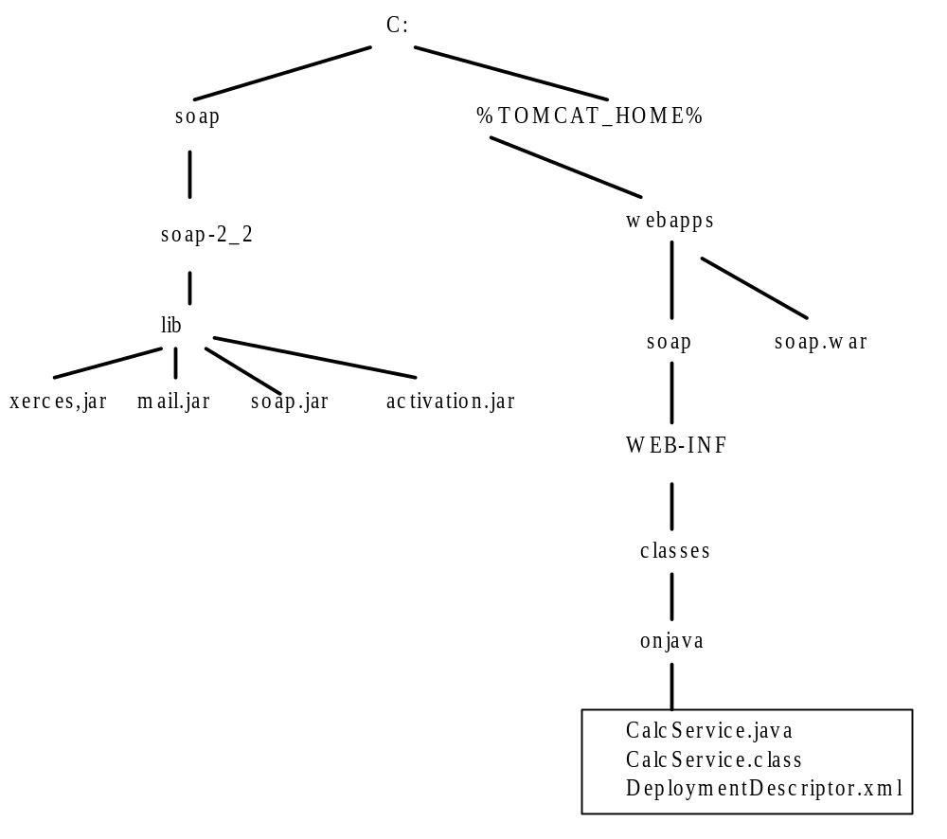
Apache SOAP installation
Distributed Computing, M. L. Liu

Slide 25
Classpath setting
set CLASSPATH=
  C:\soap\soap-2_2\lib\xerces.jar;
  C:\jdk1.3\bin;
  C:\jdk1.3\lib\tools.jar;
  C:\soap\soap-2_2\lib\mail.jar;
  C:\soap\soap-2_2\lib\soap.jar;
  C:\soap\soap-2_2\lib\activation.jar;
  C:\tomcat\lib\servlet.jar;
  .;
Distributed Computing, M. L. Liu

Slide 26
Writing a Client Application using Apache SOAP source: http://www.xmethods.com/gettingstarted/apache.html
Classpath
Your CLASSPATH environment variable should have both the "soap.jar" and "xerces.jar" JAR files included. Importing packages
For basic SOAP method invocation, you should import the following at minimum:
  // Required due to use of URL class , required by Call class
  import java.net.*;
  // Required due to use of Vector class
  import java.util.*;
  // Apache SOAP classes used by client
  import org.apache.soap.util.xml.*;
  import org.apache.soap.*;
  import org.apache.soap.rpc.*;
Distributed Computing, M. L. Liu

Slide 27
Ready-made SOAP Services
A number of SOAP ready-made services are available at http://www.xmethods.com/
XMethods Service Weather Temperature
ID8
Service Owner:xmethods.net
Contact Email:support@xmethods.net
Service Description:Current temperature in a given U.S. zipcode region.
SOAP Implementation:Apache SOAP
Distributed Computing, M. L. Liu

Slide 28
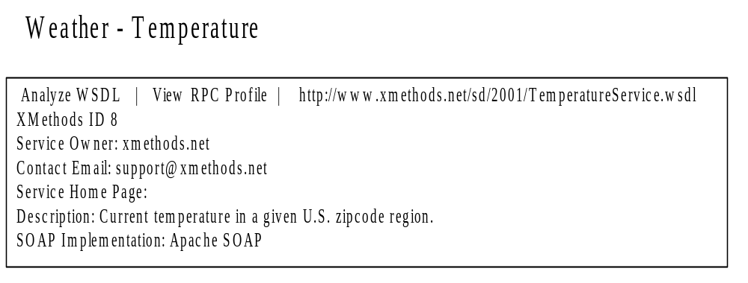
Sample SOAP service
Found at http://www.xmethods.com
Distributed Computing, M. L. Liu

Slide 29
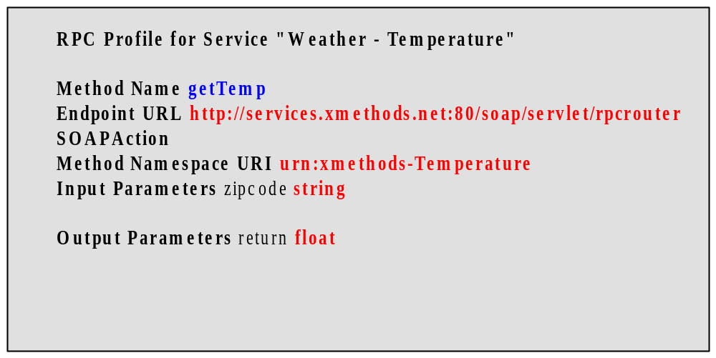
RPC Profile for Service
See sample: TempClient.java
Distributed Computing, M. L. Liu

Slide 30
Client program samples
See samples in client folder:
  TempClient.java
  StockQuoteClient.java
  CurrencyClient.java
Distributed Computing, M. L. Liu

Slide 31
SOAP data types
SOAP Data Types, http://www.sdc.iup.edu/outreach/spring2002/webservices/datatypes.html
Uses XML Schema data types
Primitive Types
string, boolean, decimal, float, double, duration, dateTime, time, date, gYearMonth, gYear, gMonthDay, gDay, gMonth, hexBinary, base64Binary, anyURI, QName, NOTATION
Distributed Computing, M. L. Liu

Slide 32
SOAP data types
Derived Types
Simple types (derived from a single primitive type)
* integer is derived from decimal
* int (-2147483648 <= int <= 2147483647) is derived from long which is derived from integer
* 5-digit zip code can be derived from int
* may use regular expressions to specify derived types, such as ([A-Z]){2,3}-\d{5}
Distributed Computing, M. L. Liu

Slide 33
Complex Type
Complex types (struct or array)
Struct example
<instructor>
<firstname xsi:type="xsd:string">Ed</firstname>
<lastname xsi:type="xsd:string">Donley</lastname> </instructor>
Array example
<mathcourses xsi:type=
"SOAP-ENC:Array" SOAP ENC:arrayType="se:string[3]"> <se:string>10452C</se:string> <se:string>10454C</se:string> <se:string>11123T</se:string>
</mathcourses>
Distributed Computing, M. L. Liu

Slide 34
Creating Web Services (server-side SOAP)
O'Reilly Network: Using SOAP with Tomcat [Feb. 27, 2002] http://www.onjava.com/pub/a/onjava/2002/02/27/tomcat.htm
Apache SOAP allows you to create and deploy a SOAP web service.
You must install some .jar files on your system and set the CLASSPATH to them:
Algorithm:
  Write a class for providing the service.
  Create a deployment descriptor in XML.
  Deploy the service with the service manager.
Distributed Computing, M. L. Liu

Slide 35
The Apache SOAP service manager
The service manager is itself implemented as a SOAP service.
To see what services are deployed on your system:
java org.apache.soap.server.ServiceManagerClient http://localhost:8080/soap/servlet/rpcrouter list
To deploy a service:
java org.apache.soap.server.ServiceManagerClient http://localhost:8080/soap/servlet/rpcrouter deploy foo.xml
Distributed Computing, M. L. Liu

Slide 36
Creating a SOAP Service
O'Reilly Network: Using SOAP with Tomcat [Feb. 27, 2002] http://www.onjava.com/pub/a/onjava/2002/02/27/tomcat.html
A SOAP service can be just about any Java class that exposes public methods for invocation. The class does not need to know anything about SOAP, or even that it is being executed as a SOAP service.
The method parameters of a SOAP service must be serializable. The available types that can be used as SOAP service parameters are shown in (Listing 2) (shown on next slide)
Distributed Computing, M. L. Liu

Slide 37
SOAP Service Parameter Types
All Java primitive types and their corresponding wrapper classes
Java arrays
java.lang.String
java.util.Date
java.util.GregorianCalendar
java.util.Vector
java.util.Hashtable
java.util.Map
Distributed Computing, M. L. Liu

Slide 38
SOAP Service Parameter Types
java.math.BigDecimal
javax.mail.internet.MimeBodyPart
java.io.InputStream
javax.activation.DataSource
javax.activation.DataHandler
org.apache.soap.util.xml.QName
org.apache.soap.rpc.Parameter
java.lang.Object (must be a JavaBean)
Distributed Computing, M. L. Liu

Slide 39
Sample SOAP Service Implementations
See sample in SOAP folder:
TempService: A temperature service
Exchange: currency exchange service and client
Distributed Computing, M. L. Liu

Slide 40
Sample SOAP Service Class
// A sample SOAP service class
// source: http://www.onjava.com/pub/a/onjava/2002/02/27/tomcat.html
package onjava;
public class CalcService {
public int add(int p1, int p2) {
return p1 + p2;
}
public int subtract(int p1, int p2) {
return p1 - p2;
}
}
Distributed Computing, M. L. Liu

Slide 41
Deployment Descriptor
<isd:service xmlns:isd="http://xml.apache.org/xml-soap/deployment"
id="urn:onjavaserver">
<isd:provider type="java"
scope="Application"
methods="add subtract">
<isd:java class="onjava.CalcService"/>
</isd:provider>
<isd:faultListener>org.apache.soap.server.DOMFaultListener</isd:faultListener>
</isd:service>
Distributed Computing, M. L. Liu

Slide 42
Summary
SOAP is a protocol that makes use of HTTP requests and responses to effect remote method calls to web services.
A SOAP method call is encoded in XML and is embedded in an HTTP request
The return value of a method call is likewise embedded and encoded in an HTTP response
A number of SOAP APIs are available for programming web services and client method calls. The Apache API was introduced.
Distributed Computing, M. L. Liu

